Slide 1

OPTIMIZING WORKFORCE EFFICIENCY: INSIGHTS FROM EMPLOYEE DATA ANALYSIS
KING-OKUNEYE EBUNOLUWA
APRIL 2025

Slide 2
INTRODUCTION
This SQL project involves optimizing workforce efficiency using Secondary data in CSV format. The primary objective is to extract meaningful insights such as employee demographics, departmental trends and salary distribution that can inform strategic decisions in areas such as employee retention, compensation planning and departmental performance.

Slide 3
PROBLEM STATEMENT
This project addresses the challenges of managing workforce data stored across multiple tables, which can lead to inefficiencies due to data inaccuracy . Using PostgreSQL, this project analyzes employee data to provide insights that enhance HR decision making.

Slide 4
PROCESS WORKFLOW
DATA COLLECTION
DATA TRANSFORMATION
DATA INSERTION
DATA QUERYING AND ANALYSIS
RECOMMENDATION AND CONCLUSION

Slide 5
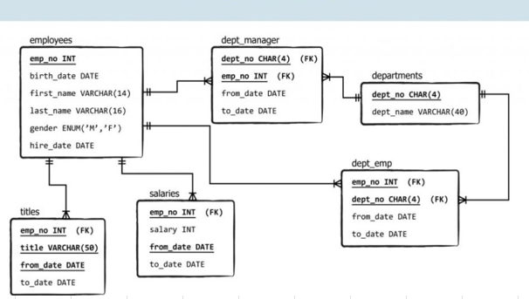
WORKFORCE SCHEMA DIAGRAM

Slide 6
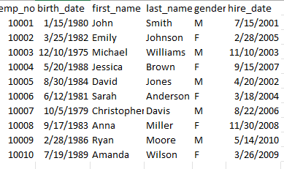
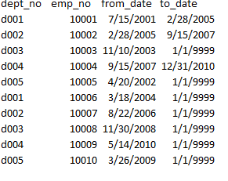
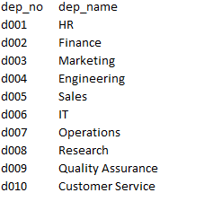
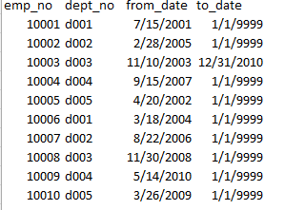
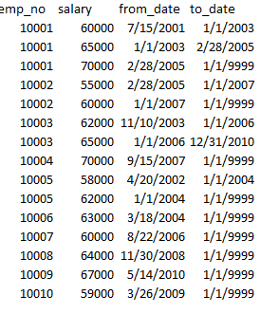
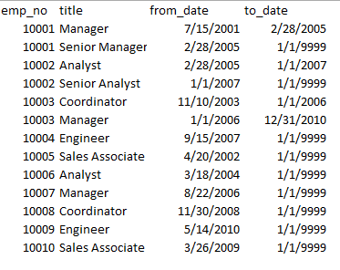
UNCLEAN DATA

Slide 7
STEP-STEP PROCESS
Convert the data from Excel format to CSV format for easy import.
Copy file address as text into binary path.
Create a new PostgreSQL database.
Create a table for each data set using the right data type (VARCHAR, INT, FLOAT, DATE).
Import the data into PostgreSQL.
Perform SQL queries for analysis using SELECT, COUNT, WHERE, MAX, AS, AVG, ORDER BY, ASC, GROUP BY AND JOIN SYNTAXES.

Slide 8
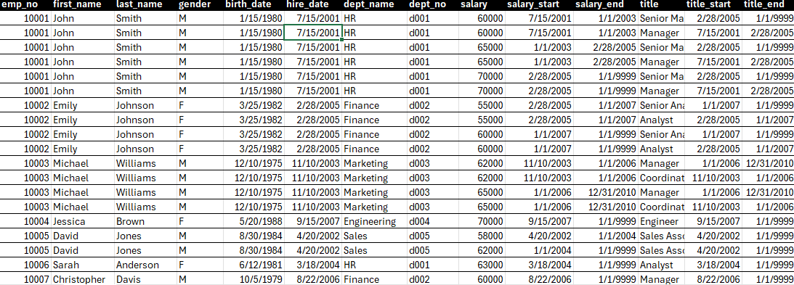
CLEANED DATA

Slide 9
ANALYSIS AND RESULT
Query 1: Retrieve the first name and last name of all employees
Query 2: Find the department numbers and names
SELECT first_name, last_name FROM employees
SELECT dept_no, dept_name FROM departments

Slide 10
ANALYSIS AND RESULT
Query 3: Get the total number of employees
Query 4: Find the average salary of all employees
Query 5: Retrieve the birth date and hire date of employee with emp_no 10003
Query 6: Get the total number of departments
SELECT COUNT(emp_no) AS total_employees FROM employees
average_salary
SELECT round(AVG(salary), 2) AS average_salary FROM salaries
62666.67
SELECT emp_no, birth_date, hire_date FROM employees
WHERE emp_no=10003
SELECT COUNT(dept_name) AS total_departments FROM departments

Slide 11
ANALYSIS AND RESULT
Query 7: Retrieve the department number and name where employee with emp_no 10004 works
Query 8: Get the average salary for each department
SELECT dept_emp.emp_no, departments.dept_no, departments.dept_name FROM departments
JOIN dept_emp ON departments.dept_no
= dept_emp.dept_no
WHERE emp_no='10004'
SELECT departments.dept_name, round(AVG(salaries.salary),2) AS avg_salary
FROM salaries
JOIN dept_emp ON salaries.emp_no= dept_emp.emp_no
JOIN departments ON dept_emp.dept_no= departments.dept_no
GROUP BY dept_name
dept_name
avg_salary
Finance
58333.33
Sales
59666.67
HR
64500.00
Marketing
63666.67
Engineering
68500.00

Slide 12

ANALYSIS AND RESULT
Query 9: Retrieve the employee number, first name, last name and title of employees who are currently managers
Query 10: Retrieve the employee number, first name, last name and department name of employees who are currently working in the finance department
SELECT employees.emp_no,
employees.first_name, employees.last_name,
employee_titles.title FROM employees
JOIN employee_titles ON employees.emp_no= employee_titles.emp_no
WHERE title='Manager' AND to_date='9999-01-01'
SELECT employees.emp_no, employees.first_name, employees.last_name,
departments.dept_name FROM employees
JOIN dept_emp ON employees.emp_no= dept_emp.emp_no
JOIN departments ON dept_emp.dept_no= departments.dept_no
WHERE dept_name='Finance’
AND to_date='9999-01-01'

Slide 13
ANALYSIS AND RESULT
Query 11: Find the gender of employee with emp_no 10007
Query 12: Retrieve the employee number, first name, last name and department name of employees who have held a managerial position
SELECT emp_no, gender FROM employees
WHERE emp_no='10007'
SELECT employees.emp_no, employees.first_name, employees.last_name, departments.dept_name
FROM employees
JOIN employee_titles ON employees.emp_no= employee_titles.emp_no
JOIN dept_emp ON employees.emp_no= dept_emp.emp_no
JOIN departments ON dept_emp.dept_no= departments.dept_no
WHERE title='Manager'

Slide 14
ANALYSIS AND RESULT
Query 13: Retrieve the employee number, first name, last name and salary of employees earning more than 60,000
Query 14: Get the total number of employees who have held the title “Senior Manager”
SELECT employees.emp_no, employees.first_name, employees.last_name,
salaries.salary FROM employees
JOIN salaries ON employees.emp_no= salaries.emp_no
WHERE salary>'60000'
SELECT COUNT(employees.emp_no) AS total_snr_manager FROM employees
JOIN employee_titles ON employees.emp_no= employee_titles.emp_no
JOIN dept_emp ON employees.emp_no= dept_emp.emp_no
JOIN departments ON dept_emp.dept_no= departments.dept_no WHERE title='Senior Manager'

Slide 15
ANALYSIS AND RESULT
Query 15: Retrieve the employee number, first name, last name and salary of employees hired before the year 2005
SELECT employees.emp_no, employees.first_name, employees.last_name,
salaries.salary, hire_date
FROM employees
JOIN salaries ON employees.emp_no= salaries.emp_no
WHERE hire_date<'2005-01-01’
ORDER BY hire_date ASC

Slide 16
RECOMMENDATION
INTEGRATE PERFORMANCE METRICS AND EMPLOYEE FEEDBACK: This can further refine workforce optimization strategies.
IMPROVE DATA INTEGRITY: It is important to ensure that data is consistently updated and accurate, especially for employee roles, salaries and department details.
REGULAR DATA AUDITS: Conduct periodic checks to validate the accuracy of employee details.
ROLE-BASED ACCESS CONTROL: Implement security measures to restrict access to sensitive employee data based on user roles.

Slide 17
LIMITATION
STATIC DATA: This analysis is based on a fixed data set and does not account for real time updates or historical changes doesn’t fully capture long term trends.
NO PERFORMANCE METRICS: The queries focused on employee roles, departments and salaries but do not include performance metrics.
MISSING RECORDS: Some departments do not have employee and salary records.
POTENTIAL DATA INCONSISTENCIES: If employee records are not regularly updated, insights may not reflect the current organizational structure.

Slide 18
CONCLUSION
This analysis provided key takeaways in workforce demographics, salary disparities and organizational structure, providing a foundation for strategic decision making. By leveraging SQL for data extraction, businesses can identify opportunities to optimize compensation models, improve resource allocation and enhance employee satisfaction.

Slide 19
THANK YOU

